Slide 1
Impact of COVID-19 on Mental Health in United States
Group D1: Jie Feng, Jungkyu Kim, Riley Williamson, Rodney Davemann,Veera Supraja Koppisetty, Felix Ogbodu
Instructor: Thomas Raczkowski
TA: Sumit Malik
Date: 05/01/2021

Slide 2
Introduction
Background:
Covid-19 pandemic
Mental health issue
Questions:
Has COVID_19 affected the mental health of Americans?
Are areas high COVID-19 deaths more impacted by mental health issues?
Do areas with low COVID-19 rates have lower rates of mental health issues?
How has Georgia been impacted?
By Veera Supraja Koppisetty

Slide 3
Data importation
Datasets:
Indicators_of_Anxiety_or_Depression_Based_on_Reported_Frequency_of_Symptoms_During_Last_7_Days(also called Anxiety_data)
COVID_Cases_And_Deaths_Data_From_2020_to_2021(Also called us_states )
We have got our required covid data , anxiety deaths data from CDC since 2020
Number of rows in Covid Data set : 23059
Number of rows in Anxiety Data set : 5784
By Veera Supraja Koppisetty

Slide 4
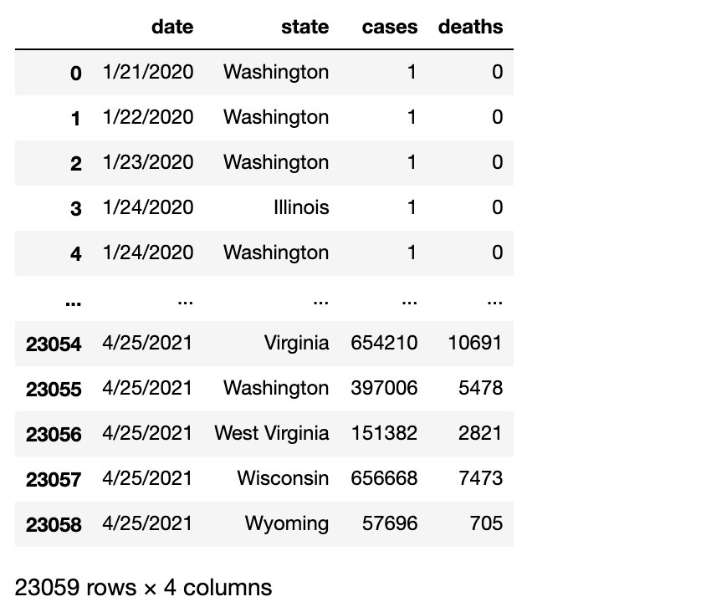
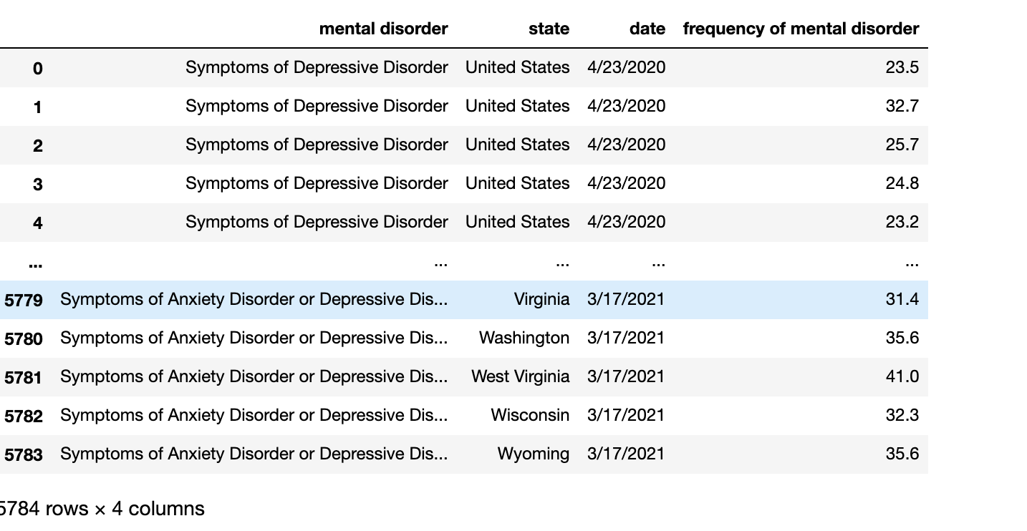
Data cleaning
Once the data has been imported, cleaned up the data by deleting unnecessary columns in both the datasets
The cleaned covid dataset now contains
The cleaned anxiety data now contains
By Jungkyu Kim

Slide 5
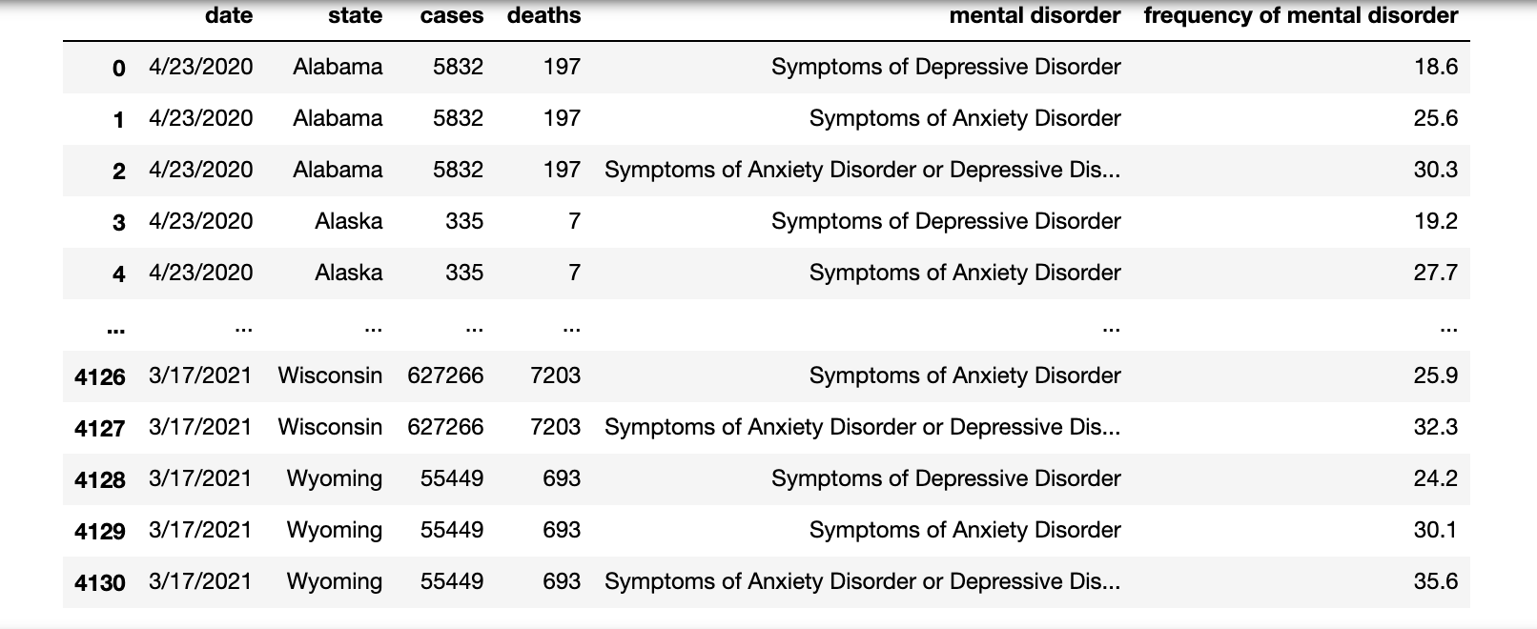
Data Merging
Merge conducted on the common column i.e., state
After the merge:
Number of rows in Merged Data set: 4131
Merged Data looks like
By
Veera Supraja Koppisetty

Slide 6
Data analysis
By Rodney Davemann

Slide 7
Data analysis Question: How has Georgia been impacted?
#get georgia data
georgia_data=merged_data.loc[merged_data["state"]=="Georgia"]
#display georgia data
display(georgia_data)
#group georgia data by date
georgia_data_group_by_date=georgia_data.groupby(["date"],sort=False)
#get the mean
georgia_data_group_by_date_mean=georgia_data_group_by_date.mean()
By Jie Feng

Slide 8
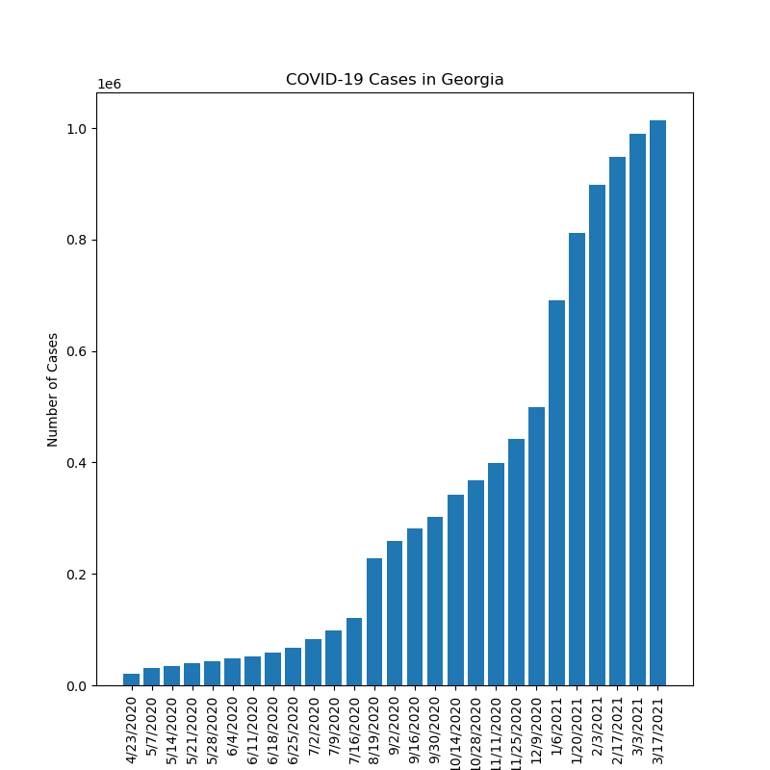
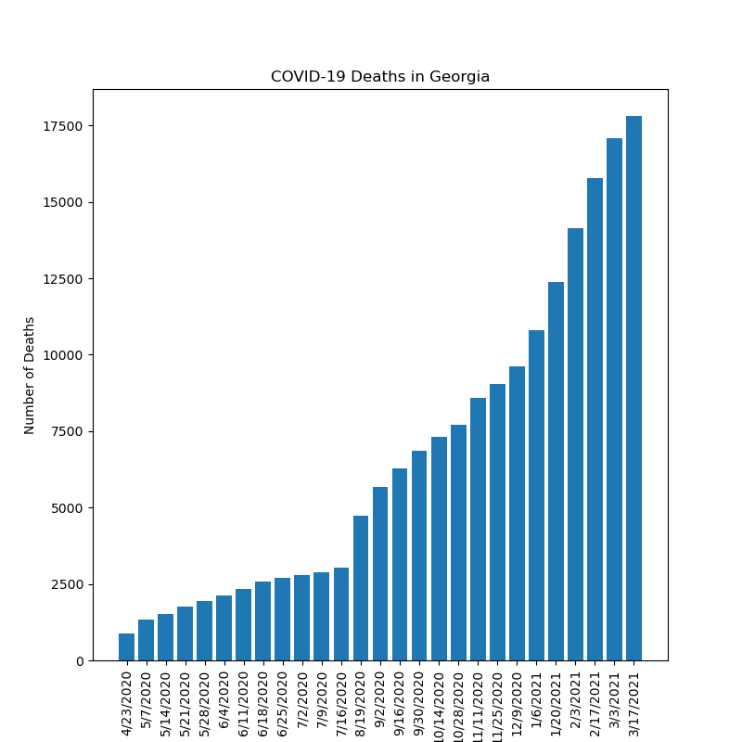
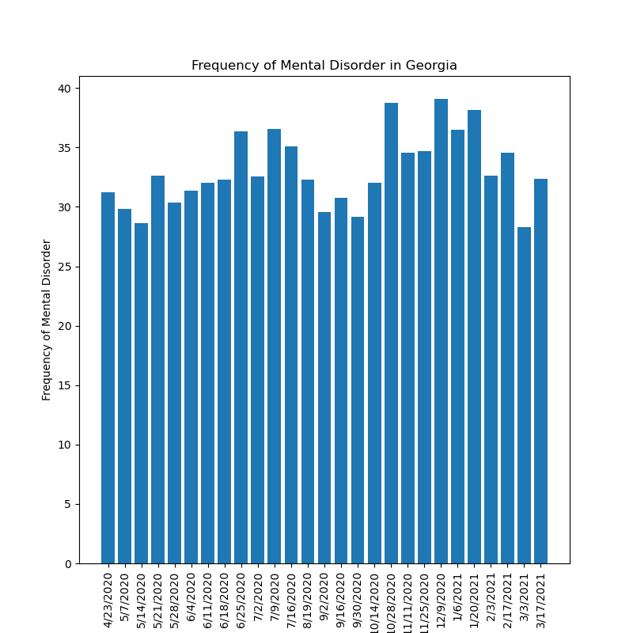
Data analysis Question: How has Georgia been impacted?
By Jie Feng

Slide 9
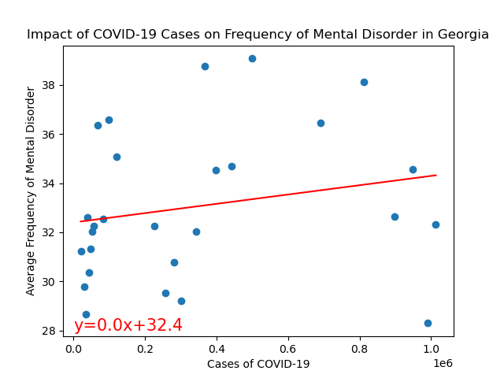
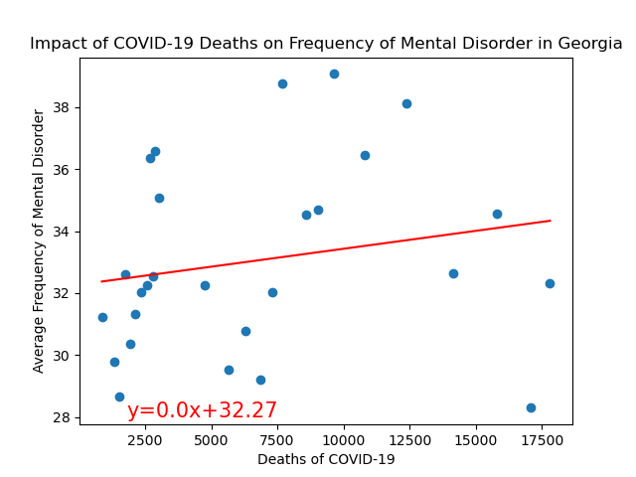
Data analysis Question: How has Georgia been impacted?
The r value is 0.04.
The r value is 0.04.
By Jie Feng

Slide 10
Graphing
By Felix Ogbodu

Slide 11
Graphing
By Jungkyu Kim

Slide 12
Summary statistics
By Riley Williamson

Slide 13
P-test
By Riley Williamson

Slide 14
Conclusion
By Veera Supraja Koppisetty

